Slide 1
Mini Popper | Colt poppers | Pepper poppers | Plates | Wall feet
6 | 2 | 2 | 0 | 74
Bay | Stage | Target Type | Count | NS | Total | Hard Cover
A2 | Double Trouble | USPSA | 9 | 3 | 12 | 1 Tux 2 Right Diag 1 50%
A1 | Periscope | USPSA | 9 | 2 | 11 | 2 Tux 1 50%
B1 | Z for Zero | USPSA | 14 | 2 | 16
B2 | Dysfunction Junction | USPSA | 10 | 3 | 13 | 2 Tux
B3 | All the Single Turtles | IPSC | 10 | 2 | 12 | 2 Tux
B4 | 20-01 | USPSA | 5 | 1 | 6
IPSC | Tux | 2
IPSC | Left Diag | 0
IPSC | Right Diag | 0
IPSC | 50.00% | 0
USPSA | Tux | 5
USPSA | Left Diag | 0
USPSA | Right Diag | 2
USPSA | 50.00% | 2

Slide 2
Prop | Stage

Slide 3

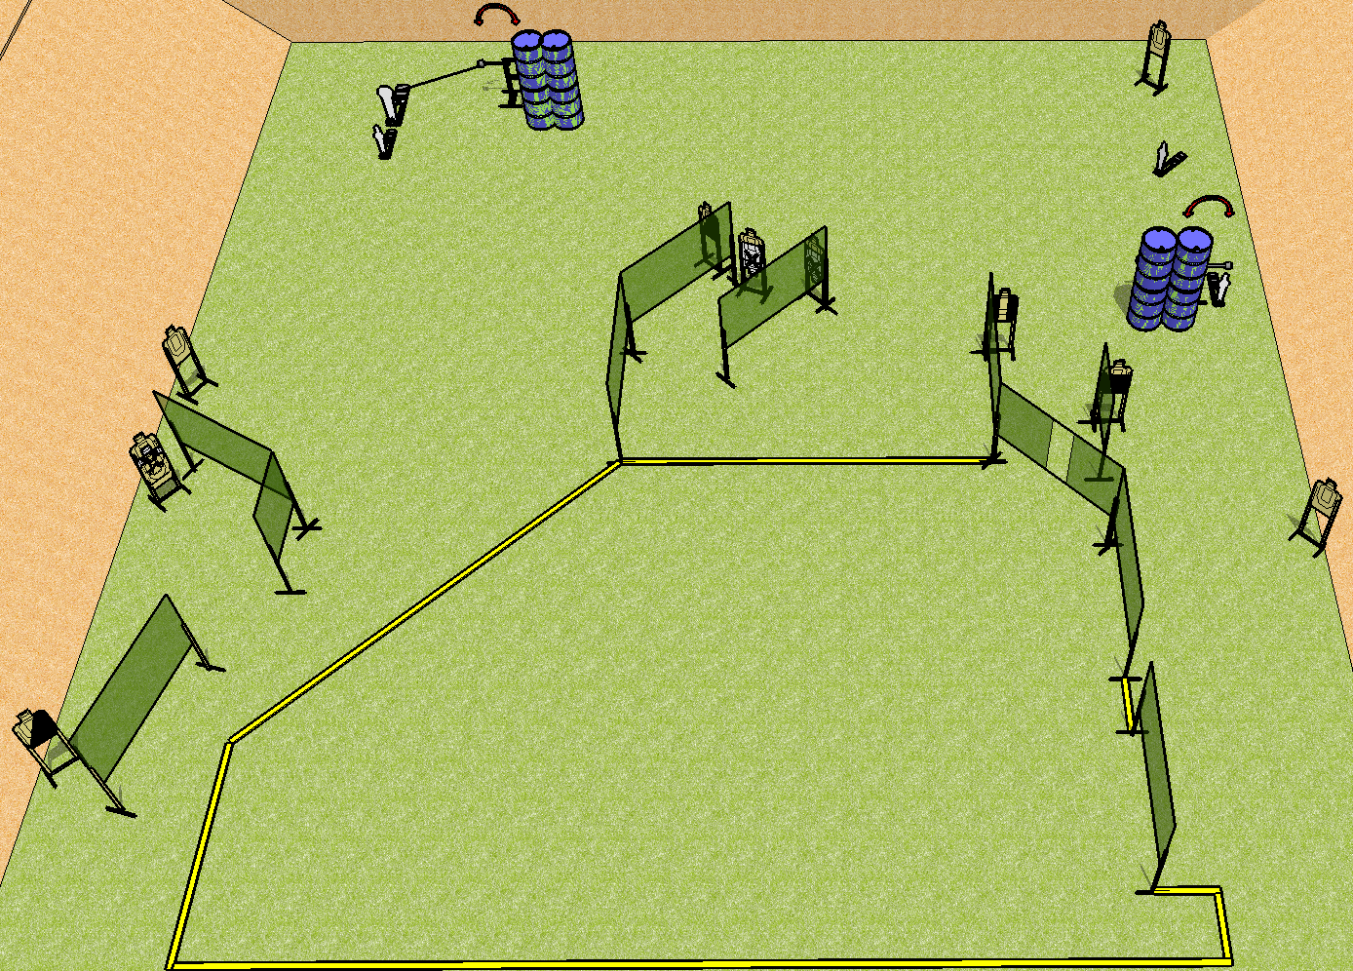
 | Dothan Practical Shooters – USPSA Match Double Trouble Course Designer : Drew Coleman Bay: A2
Round Count 30 rounds 13 USPSA 1 colt popper, 3 mini poppers
Equipment List 20 wall feet 2 swingers + activator 1 tux, 2 right diag, 1 50% 12 targets (9 + 3NS)

Slide 4
Double Trouble
Written Stage Briefing
Scoring: Comstock Rounds: 30
Targets: 13 USPSA, 4 steel
Handgun start position: anywhere inside the shooting area, wrists below belt. Handgun is loaded and holstered.
PCC start position: anywhere inside the shooting area, stock on belt. Loaded carbine is held with both hands, stock on belt.
Stage Procedure: on the audible start signal, engage targets as they become available from within the shooting area. S1 is activated by P2 and remains visible at rest, S2 is activated by P4 and remains visible at rest.

Slide 5
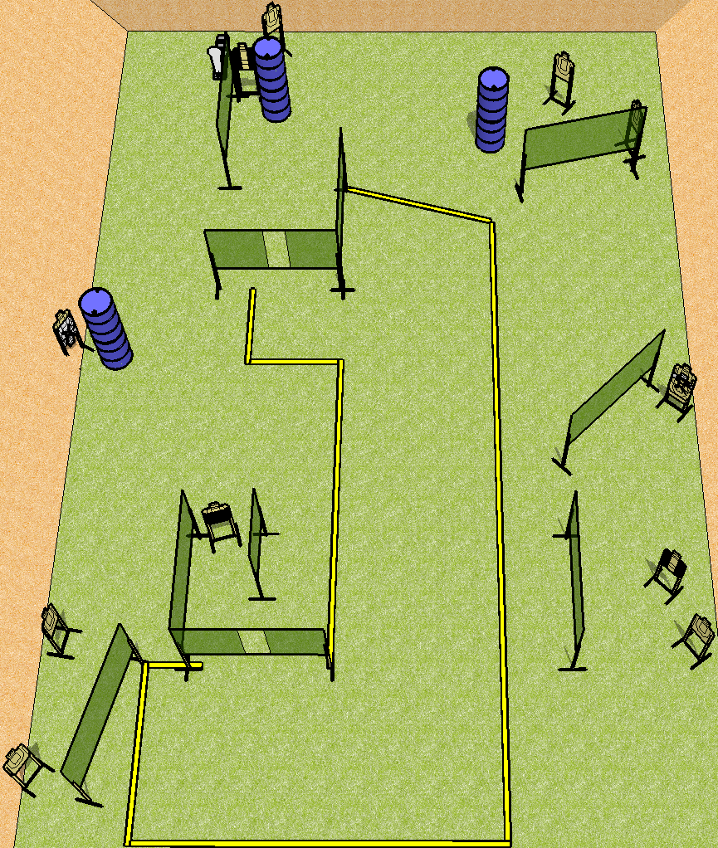
 | Dothan Practical Shooters – USPSA Match Periscope Course Designer : Drew Coleman Bay: A1
Round Count 25 rounds 12 USPSA 1 colt popper
Equipment List 18 wall feet 2 tux, 1 50% 11 targets (9 + 2NS)

Slide 6
Periscope
Written Stage Briefing
Scoring: Comstock Rounds: 25
Targets: 12 USPSA, steel
Handgun start position: hands touching marks, pistol loaded and holstered.
PCC start position: muzzle touching either mark, stock on belt. Loaded carbine is held with both hands.
Stage Procedure: on the audible start signal, engage targets as they become available from within the shooting area.

Slide 7
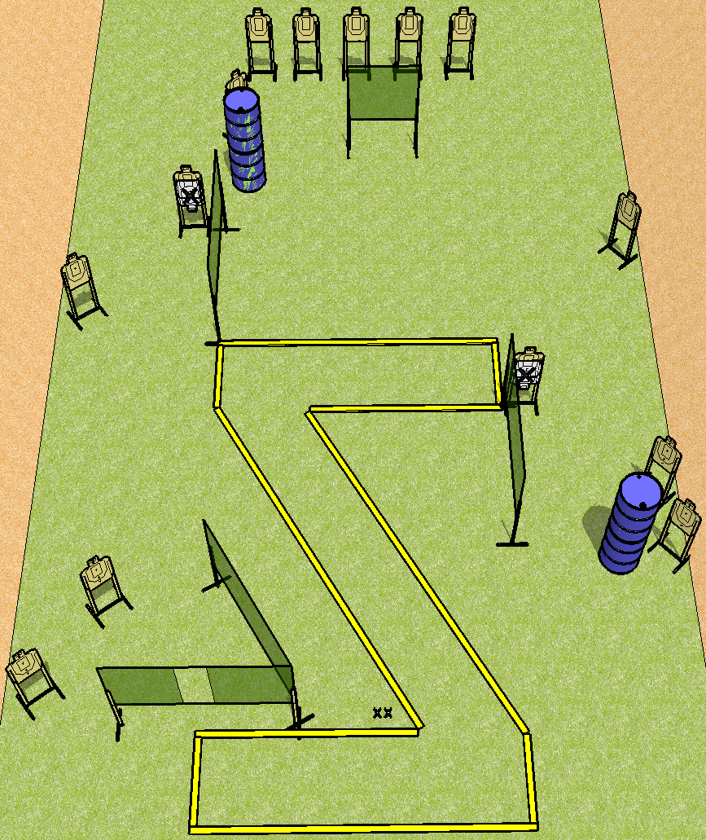
 | Dothan Practical Shooters – USPSA Match Z for Zero Course Designer : Drew Coleman Bay: B1
Round Count 28 rounds 14 USPSA
Equipment List 10 wall feet 16 targets (14 + 2NS)

Slide 8
Z for Zero
Written Stage Briefing
Scoring: Comstock Rounds: 28
Targets: 14
Handgun start position: feet on X’s, wrists below belt. Handgun is loaded and holstered.
PCC start position: feet on X’s, stock on belt. Loaded carbine is held with both hands.
Stage Procedure: on the audible start signal, engage targets as they become available from within the shooting area.

Slide 9
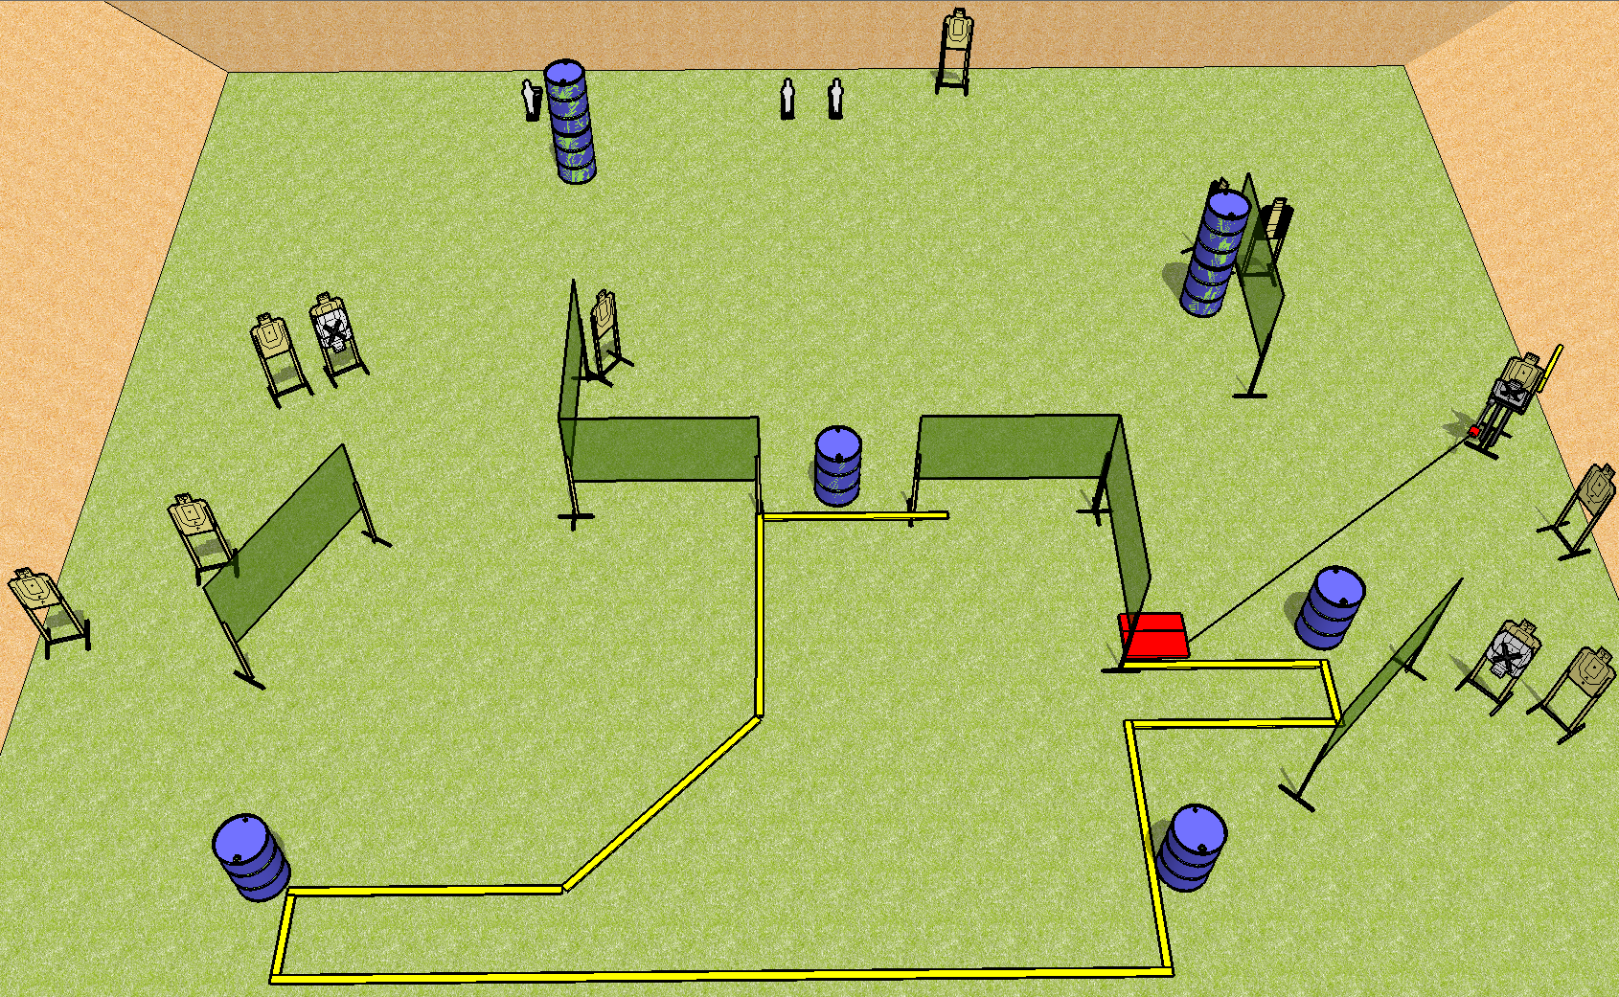
 | Dothan Practical Shooters – USPSA Match Dysfunction Junction Course Designer : Drew Coleman Bay: B2
Round Count 27 rounds 12 USPSA 3 mini poppers
Equipment List 12 wall feet Max trap + stomp pad 2 tux 13 (10 + 3NS)

Slide 10
Dysfunction Junction
Written Stage Briefing
Scoring: Comstock Rounds: 27
Targets: 12 USPSA, 3 steel
Start position: anywhere completely outside the shooting area, fingers touching ears. Firearm is on any barrel, unloaded and unpropped. All magazines to be used must start on any other barrel.
Stage Procedure: on the audible start signal, engage targets as they become available from within the shooting area. The max trap is activated by the stomp pad and remains visible at rest.

Slide 11
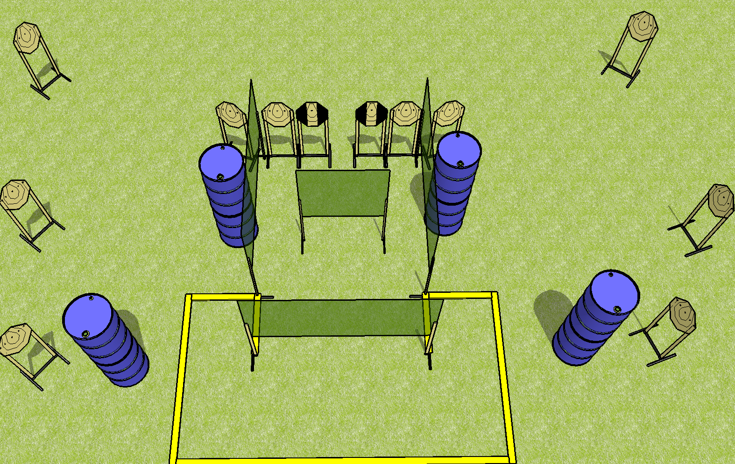
 | Dothan Practical Shooters – USPSA Match All the Single Turtles Course Designer : Drew Coleman Bay: B3
Round Count 12 rounds 12 IPSC
Equipment List 8 wall feet 2 tux 12 targets (10 + 2NS)

Slide 12
All the Single Turtles
Written Stage Briefing
Scoring: Comstock Rounds: 12
Targets: 12 IPSC
Best 1 hit per target
Handgun start position: anywhere completely outside the shooting area, wrists above shoulders. Handgun is loaded and holstered.
PCC start position: anywhere completely outside the shooting area, wrists above shoulders. Loaded carbine is held with both hands.
Stage Procedure: on the audible start signal, engage targets as they become available from within the shooting area.

